Slide 1
Cyber Security in Digital Substation
siemens.com/digital-substation
Unrestricted © Siemens AG 2019
Notes:
Digitalization is currently being discussed in all industrial sectors and simply everywhere in society. Also our customers are very concerned about this topic – did they already ask you? Everybody feels there must be potentials resulting from Digitalization, but making them concrete is mostly still quite a challenge.
Electricial Substations are a core portfolio element of Siemens Energy Management. In this presentation, answers are provided to the questions how Digitalization can conceretely be applied within a Substation and what benefits this may bring.

Slide 2
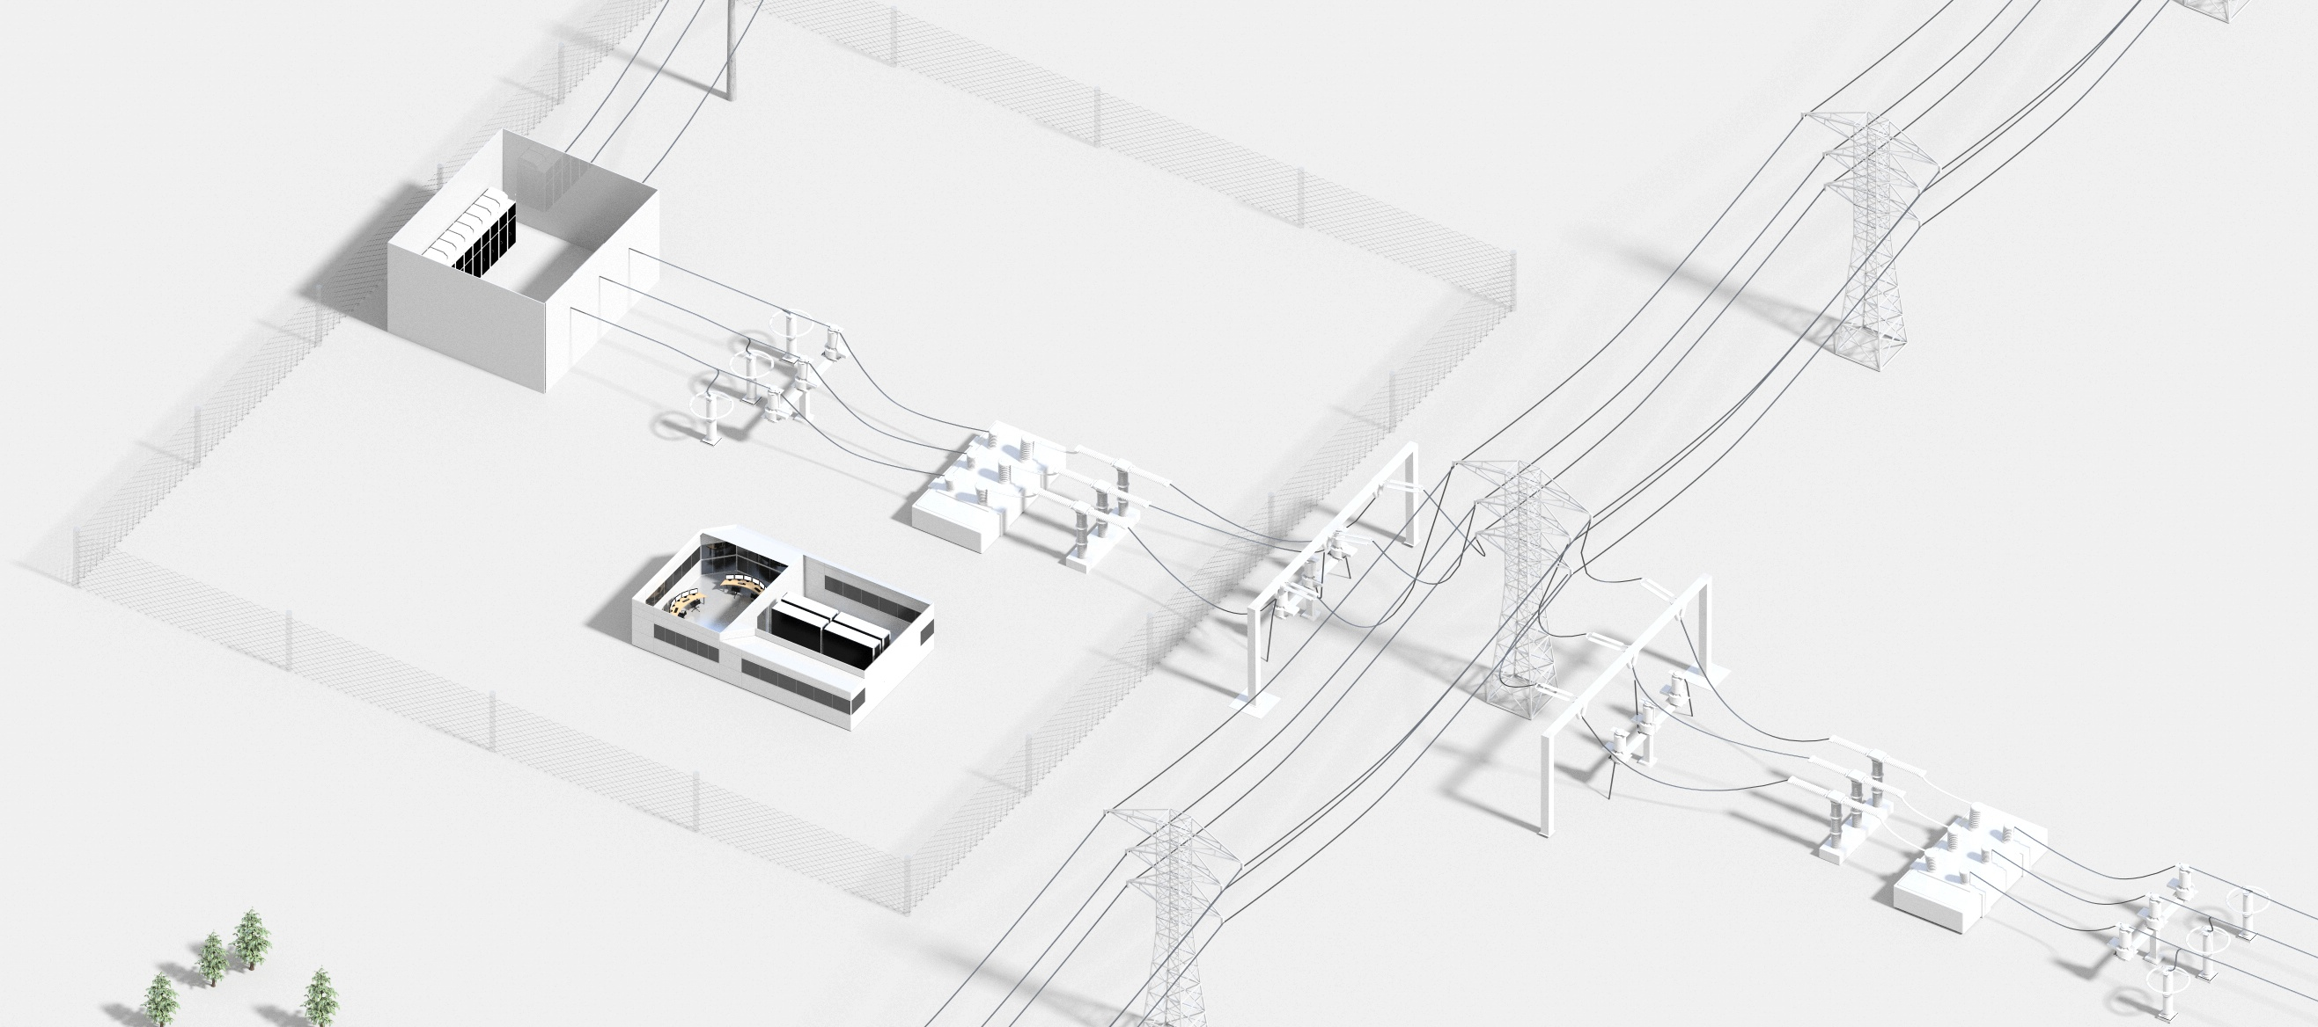
A Substation –
Why Should We Make It Digital?
Quality assurance
Ensuring
grid
availability
and
reliability
Avoid human errors
Reduce maintenance expenses
Adopt new business models
Business
agility
Avoid
outages
Operational
efficiency
Reduce outage times
Investment security
Privacy and security of data
Time to operation
Managing of
investments
Asset productivity and lifecycle
Standardization
Regulatory compliance
Reduce total cost of ownership
Environmental impact
Reduce investments costs
Reduced space
Notes:
This is a substation, including a high-voltage part and potentially a medium-voltage part. Now you may ask: Why should we make it digital?
Well, the world is not at all static. Grid operators are facing new challenges:
Fluctuating infeed and dynamic consumption, but also ageing grids are threatening grid availability and reliability.
Grid operators are acting in increasingly competitive business environments. They need to manage their investments carefully…
…and continuously improve their operational efficiency.
And the world is changing faster and faster. Whatever decisions are made today, every grid operator must assure the ability to new situations and challenges in the future in an agile manner.
These challenges result in concrete tasks.
For example:
Reduced outage time is a task in the context of both grid availability and reliability and operational efficiency.
Investment security is a must when managing investments, but it is also a precondition to be agile and not to be locked in by investment decisions made previously.
Making a substation digital may help a lot to perform these tasks. Later we will transparently show how each of these tasks may be supported by a Digital Substation.

Slide 3

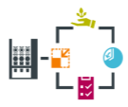




A Digital Substation –
What is it about?
2
2
2
Digitalization
of Station Level
Non-conventional Instrument
transformers (LPITs)
Provide primary values to the merging
units based on new principles
Merging Units (MU)
Converts analog primary values
of the LPITs in digital information
(Sampled Measured Values)
Process Bus
Communicates field data to
protection and control system
based on IEC 61850-9-2
1
Digitalization of
Process Level
2
4
Cyber
Security
Sensors
Provide more information on current
status of the electrical equipment
3
Asset Management
4
Grid Operation
5
3
4
5
IoT
Value-adding central applications
Big data analytics IT/OT integration
Integrated
Engineering
6
3
4
5
6
1
Digital Control Room
More data acquisition, intelligent
decentral applications, cyber security
Digital Control Room
Digital protection and automation
with station bus based on IEC 61850
Notes:
Your customers might say: “Why do you start talking about Digital Substations now? I have been purchasing Digital Substations, including digital protection relays, bay controllers, digital Station Bus based on IEC 61850 etc. for many years.” This is of course true – a digitalized Station Bus is of course the first action field when making a substation digital. And we will see that further digitalization brings some advantages here, too.
In addition, digital technologies are now used even one level further down to the process. Current and voltage are now acquired using new, low-power measuring principles, by so-called NCITs (Non-conventional instrument transformers). So-called Merging Units, installed next to the switchyard, convert their outputs into digital data points, so-called Sampled Measured Values (SMV), that are available to all subscribers of the Process Bus, based on the IEC61850-9-2 protocol.
Additional sensors may acquire more data about the current status of the electrical equipment in the field.
All data is acquired in the Digital Control Room, and intelligent applications using this data may be implemented here.
Cyber Security is a fundamental requirement in the context of Digitalization and well-defined measures, following a holistic concept, need to be implemented.
Previously, the data that left the substation towards a central level were basically monitoring and control signals to the control centre. In the digital age, in a IoT approach, all kind of data availble in a substation can be brought to a central level, to a „data lake“, to a powerful open, scalable and therefore future-proof IoT platform like MindSphere, to enable value-adding central applications, correlate data from different sources and perform big data analytics, and create the basis for IT/OT integration.
These technological possibilities may enable use cases to support Cyber Security Management, Asset Management and Grid Operation.
Last but not least, substation engineering is a task that requires and produces huge amounts of data. Managing this data in one master data set and integrating the data flow between all engineering steps, this is another significant aspect of a digital substation.
The main target group of this concept are utilities, this means DSOs and TSOs. They are facing the challenges and tasks mentionmed before, and some of these offerings are taylored to these target groups. A couple of other elements are however definitely relevant for industrial grid operators, too, so you might use at least parts of this concept for this target group, too.

Slide 4
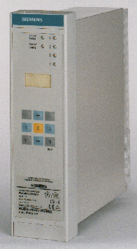
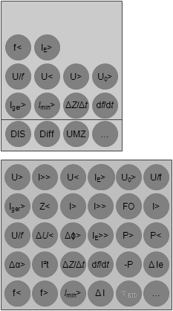
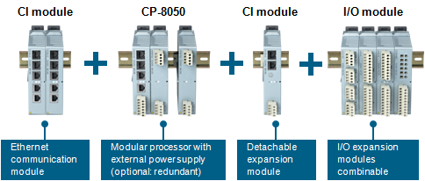
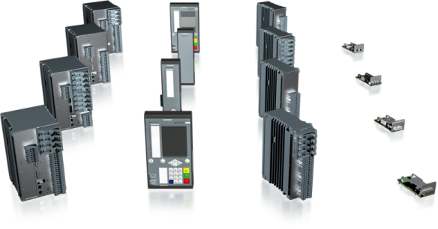

Digitalization of Station Level
1
Serial communication
on station level
Hardware and functionality
as one fix unit
Previously
HMI
Substation
controller
…
Ethernet communication
on station level
Flexibility throughout
the life time – Functions and apps are independent from a modular hardware
Switch
HMI
Digital
Substation
controller
SICAM
A8000
Benefits
  Agility regarding
  future requirements
  Investment security
Switch
IEC 61850
Station Bus
Bay
…
SIPROTEC 5
Notes:
As said before, a Digital Station Level, including digital protection relays and RTUs and Ethernet communication on station level, is actually something usual in the market for quite some years now. But also in this area there are significant innovations, preparing the ground for the use of future technologies that may not even be known today.
The key is modularity and scalability of IEDs throughout their lifetime, for both hardware and software. Extension modules enabling for instance new communication possibilities can be added to existing devices even years after commissioning. Using new protection functions in an existing relay is just a question of configuration. And powerful automation devices may host decentral, evolving applications that help to master the complex challenges in a dynamically changing technical and economical environment.
The powerful Siemens platforms SIPROTEC 5 and SICAM A8000 perfectly fulfil these requirements.
This agility to cope smoothly with new upcoming requirements is a decisive factor in the context of digitalization, and it provides investment security for investments that are made today.

Slide 5
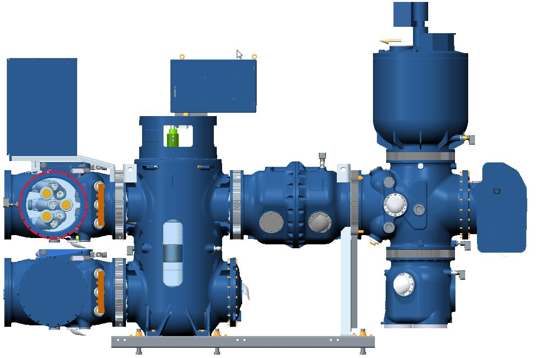
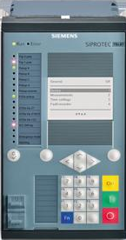
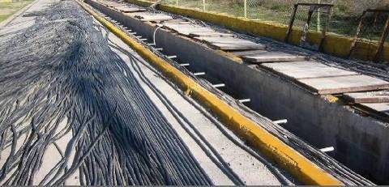
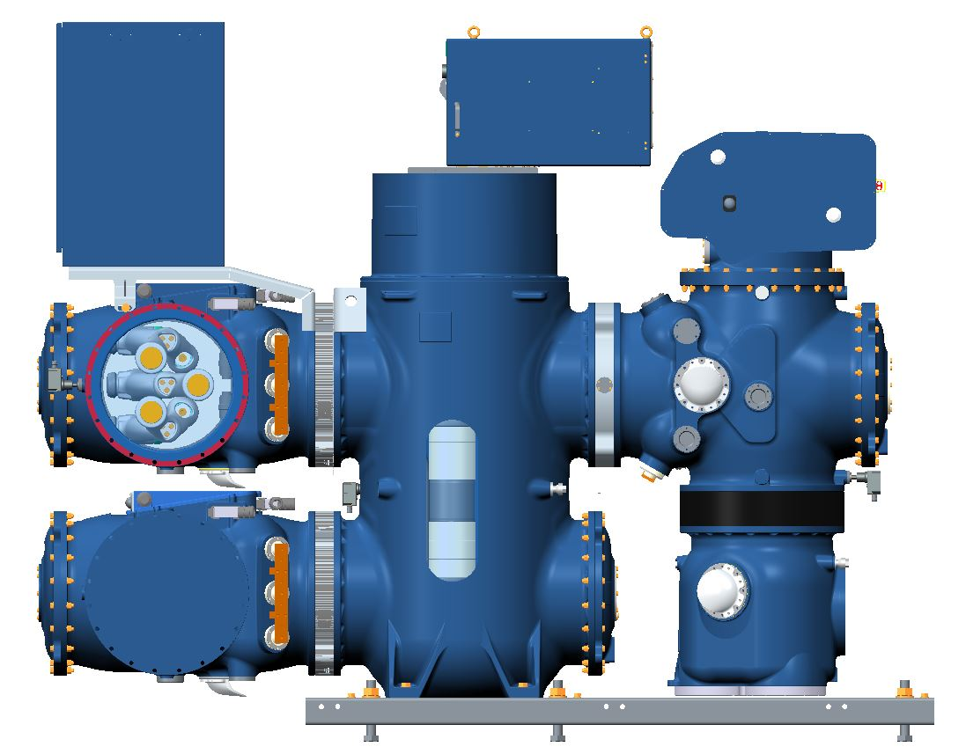

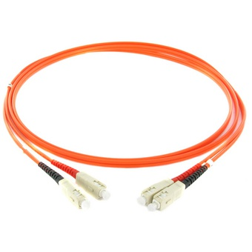
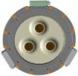
Digitalization of Process Level
2
e.g. 5 m
50 – 250 m
Control Center
VT
Substation Controller
Previously
Station bus
e.g. 3.2 m
Copper cabling
CT
Parallel wiring
Analog values
Protection House
Control Center
Benefits
  Reduced space and weight
  Higher performance in measurement
  Cost savings by reduced wiring
  Improved safety
  Interoperability
  Flexible assignment of functions
Merging
Unit
Substation Controller
IEC 61850
LPIT
Station bus
Digital
e.g. 2.9 m
Fibre optic
cabling
Ethernet
IEC 61850-9-2
Process bus based on IEC61850-9-2
e.g. 3.5 m
Protection House
Notes:
The concept of a fully digitalized Process Level includes so-called LPITs (Low-power Instrument Transformers) that replace conventional CTs (current transaformers) and VTs (voltage transformers), using new measurement principles and showing an improved measurement performance, namely avoiding ferro-resonance effects and covering a very wide measuring range (there is no ratio to be considered). If used in GIS switchgears, their size and weight are reduced significantly compared with conventional CTs and VTs.
The Merging Units are installed very close to the switchyard and transform the output signals of the LPITs or – depending on their type, if no LPITs are used – of conventional CTs and VTs into digital data points, so-called Sampled Measured Values. The measurements are thus available – practically from the switchyard on – in a digital format. This reduces cost-effective hardwiring significantly. Safety is improved, as electrical signals no longer reach the protection room.
The Sampled Measured Values that are provided by the Merging Unit according to IEC 61850-9-2 in the Process Bus can be used by components of different vendors for various applications. One protection relay is not necessarily linked to one measuring point. This provides many functional possibilities and a maximum of flexibility and scalability.

Slide 6
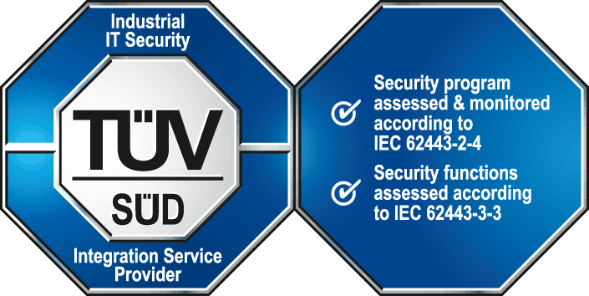




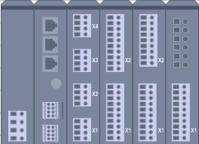


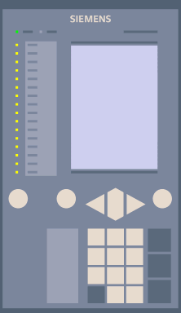

Cyber Security
3
IEC 62443 Certified
Blueprint
  Certified by TÜV SÜD according to
  IEC 62443-2-4 – Integrator processes
  IEC 62443-3-3 – Technical functionalities
Cyber security measures
Monitoring
DMZ
Access control and
account management
Control center
…
SIEM/SOC System
AD Server Radius
Certificate Manager
Untrusted network
Remote access
LOG
Security logging
and monitoring
LOG
Trusted zone
Station level
DMZ
System hardening
Service
PC
AD Server RADIUS
Syslog
Server
Certificate Manager
Router
HMI
PC
Station controller
Security patching,
Backup and restore
LOG
LOG
Malware protection
Field level
Trusted zone
Process Bus Communication
LOG
Data protection, data integrity
and system architecture
IEDs
Protection and
field devices
Secure remote access
LOG
Merging units
Notes:
Cyber Security needs to be addressed in a holistic approach. Let me explain this to you with the example of a house that you want to protect against burglars. You might build in a very solid entry door. But what about the windows? The good protection of the entry door is worth nothing if you do not foresee an appropriate protection for the windows. On the other hand, implementing the best possible measure at every point can become quite costly.
This means that first of all, in an assessment phase, an individual Cyber Security strategy including people, processes and adequate technical measures for the entire infrastructure – going in fact beyond the Digital Substation – needs to be defined.
These technical measures need then to be implemented in the next step.
A substation is definitely a critical infrastructure – with a couple of special conditions: continuous operation, components from different vendors and of different ages, proprietary systems as well as standard IT components. For this special environment, Siemens has developed a set of appropriate Cyber Security measures that it applies systematically during substation engineering, including system hardening, malware protection and access control.
The international standard IEC 62443 is designed to verify the effectiveness of Cyber Security measures in system integration, and the Siemens Secure Substation concept is externally certified by the German certification body TÜV Süd according to this standard.
Implementing Cyber Security measures once in order to achieve a certain level of security is frequently not sufficient to maintain the same level of security over the lifetime of the substation. New vulnerabilities and with them new cyber risks continuously occur. As a response to this, Siemens offers dedicated services to maintain the security level of a substation throughout its lifetime, like patch management.

Slide 7
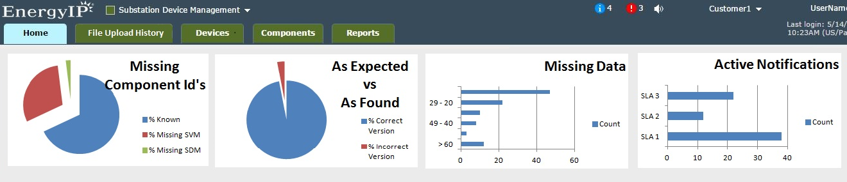




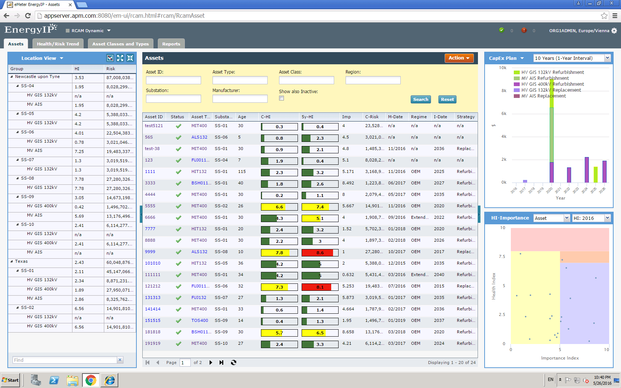
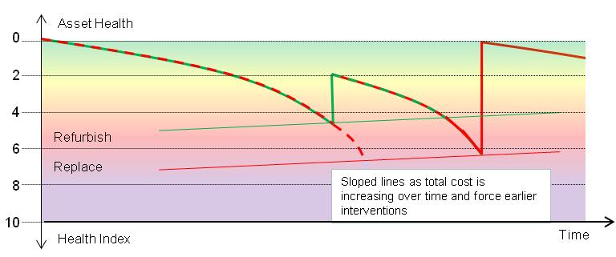
Asset Management Support for Primary and Secondary Equipment
4
Benefits
  Lower investment and operational costs
  Higher performance by improved reliability, availability
  and updated security
  Efficient processes by conscious decisions and action
Enterprise Resource
Planning
Siemens ProductCERT
Central Database
Commercial
Purchasing
Monitoring and Information
Security Research
CERT
network
3rd Party Vendors
Human Resources
etc.
Condition Monitoring
Substation Device Mgt.
Pentesters
US ICS-CERT
Free-time Hackers
BSI
IT-Security Contractors
…
…
Primary Hardware
Secondary Hardware
Sensor
Sensor
Sensor
Sensor
Health Index
Sensor
Importance Index
Notes:
Digitalization and the Internet of Things allow to acquire more data from the substation equipment – data that may be used for asset management.
The mandate for primary asset management is with EM TS CS.
These colleagues offer an application for Asset Performance Management of primary assets. This takes into account substation data like oil density of a transformer or gas pressure of a GIS switchgear, recognizes trends in these measurements and – together with information regarding the strategic relevance of the asset in the grid – provides well-founded recommendations for maintenance and investment strategies, recommendations when is the most economical point in time to perform a maintenance action or a replacement of an asset.
Management of secondary assets – IEDs, PCs and software, a mandate of EM DG – is quite different. From the hardware side, they are practically maintenance-free, but transparency on software and firmware versions are a complex task, regarding fuctional requirements, but even more as a result of the rising significance of Cyber Security management. The Substation Device Management application, running on EnergyIP (the vertical platform of MindSphere), is designed to cope with this challenge, acquiring the up-to-date version of an IED or a software in the field and comparing it with updated recommendations from the ProductCERT.
Asset Management is not an isolated technical task, but the findings from technical Asset Management are of high interest to commercial Enterprise Ressource Planning, into which they can be integrated.
In this way, Asset Management can lower investments and operational maintenance expenditures, increase performance, reliability, availability and security of the assets, and increase the efficiency of processes and the quality of decisions.

Slide 8
Grid Operation Support
Power Distribution:
Self-optimizing Applications
5
Regional Controller in Digital Primary Substation
Self-healing application
Load Management application
Area Voltage Control application
Time zero
15 sec
5 sec
10 sec
2 sec
Less than
1 minute
Benefits
  Avoidance of outages
  Reduction of outage times
  Protection of primary equipment
Service restoration
Fault location
Fault isolation
Notes:
A Digital Substation does not only provide data to a central level, to applications that help stabilizing the transmission grid, but it also acquires data from the underlying power distribution grid, and it may host applications that improve grid availability and optimize the power flow on that level.
In this way, a fault in the meshed distribution grid can be isolated, and the service can be restrored within seconds, by changing the position of the normally open point.
But positions of normally open points may also be changed in order to balance the load flow in different parts of the distribution grid. This prevents overload scenarios that might lead to outages right from the beginning, preserving primary equipment. Also, voltage deviations, for instance caused by renewable infeed or dynamic loads, can be identified and rectified by triggering the tap changer of the transformer.
In a challenging environment of renewable infeed, fluctuating loads and limitations of existing grids, outages can be avoided and outage times reduced, fault localization times limited, primary equipment preserved, and regulatory requirements achieved. And this by using the substation automation system as a basis, and – as far as existing – the automated secondary substations underneath.

Slide 9
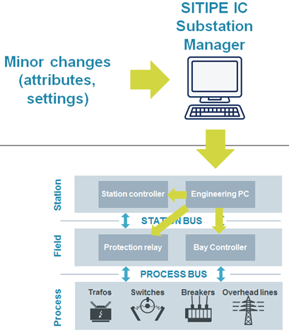
Integrated Engineering
6
Grid Operator
Data
to supplier
Data
from supplier
Single line
diagram
Secondary
drawings
Device
Configuration
Test Cases
Primary (basic)
engineering
Secondary engineering
Protection devices configuration
Test
engineering
Asset
management
RTU
configuration
HMI
configuration
SITIPE Platform
Supplier Process
Benefits
  Reduced time to operation
  Data consistency
  Optimized refurbishment process:
  easier updating of documentation and testing
Quality
Project timeline
Notes:
Substation Engineering requires a huge amount of data. For us, Digitalization is also about managing and using this data in a more integrated way. This is another aspect of a Digital Substation.
A lot of data needs to be exchanged between the grid operator and its supplier of substation systems, and traditionally this happens mainly by paper documents, with the consequence that the data needs to be processed manually to design the automation system. Exchanging this data in an aligned digital format may avoid manual data processing, in this way increase efficiency and avoid human errors.
But also when we take a look inside the supplier-internal engineering process, this data needs to be provided for various tasks and in many different tools and systems: primary engineering, secondary engineering, configuration of protection relays, of Bay Controllers, of RTUs, of substation automation systems, their HMIs; also test books need to be edited and so on.
Digitalization allows to have a single master data set – in our SITIPE platform, this stands for SIemens Totally Integrated Power Engineering – that is used by all tools and systems and for all of these work steps.
Typicals are defined once between grid operator and supplier, and the data describing an individual substation is exchanged in a defined electronic format is directly imported into the master data set. The typicals are then automatically adapted according to the actual design of the individual substation, and all required, engineering documents, configuration files and test books are generated.
Avoiding redundant data entries and the availability of a master data set provide a high level of quality and reduces time to operation significantly. As the master data set remains available throughout the life time of the substation, also its later refurbishment or extension and the related update of documentation and configuration files is simplified a lot.

Slide 10
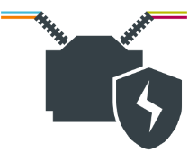
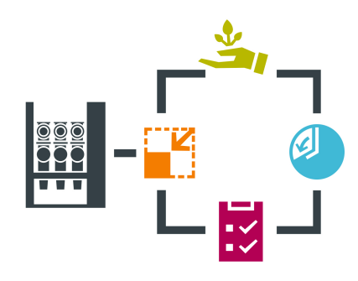


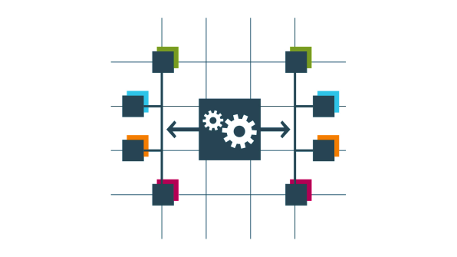

Digital Substation –
Siemens Concept Clearly Addresses
Grid Operators’ Tasks
Digitalization of Station Level
1
x
x
x
x
x
x
Digitalization of Process Level
Reduce CAPEX
Reduce TCO
Investment
Security
Avoid
human errors
Reduce OPEX
Asset
productivity
Avoid outages
Privacy and
security of data
Time to
operation
Adopt new busi-
ness models
Regulatory
compliance
Reduce
outage times
Quality
assurance
Standardization
x
x
Environmental
impact
2
x
x
x
Cyber Security
3
x
x
x
x
x
Asset Mgt. Support
4
x
x
x
x
x
x
x
x
Grid Operation Support
5
x
x
x
x
x
Integrated Engineering
6
x
x
x
x
x
x
Notes:
Here we see now which of the tasks identified earlier can be supported by digitalizing a substation in which field.
Certainly not all action fields are relevant to all customers, and certainly not to all stakeholders within a customer organization.
This concept shall serve as an overview, to start the discussion. Based on the most important tasks of your counterpart, one or another aspect may be the natural focus of your following discussion. In this context, this internal “selection guide” may help you for orientation.

Slide 11
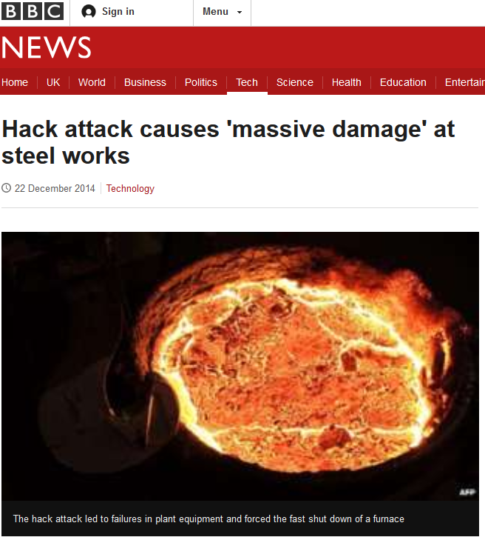

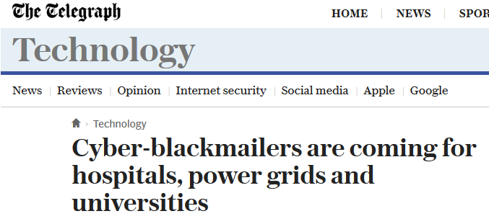
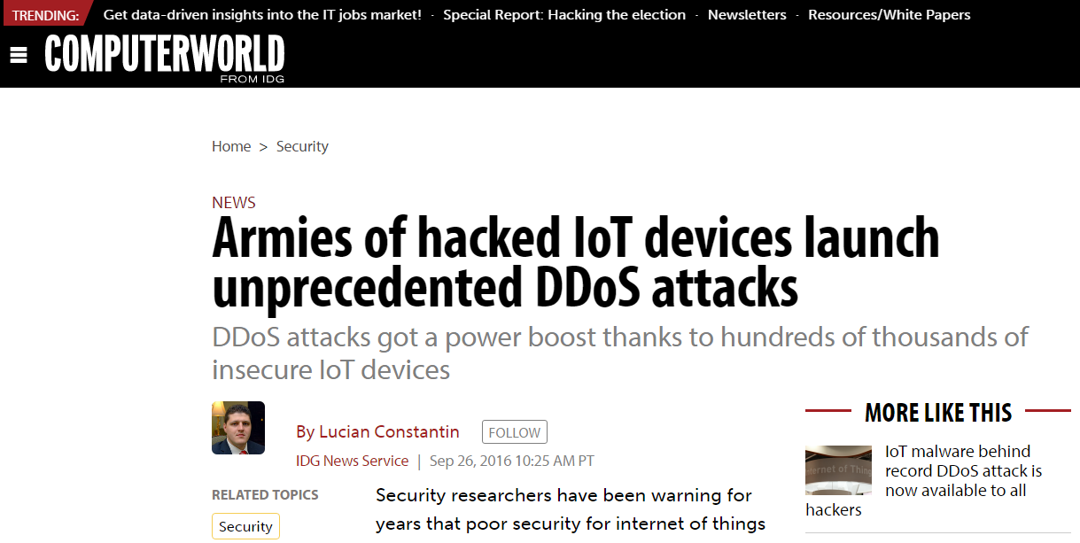
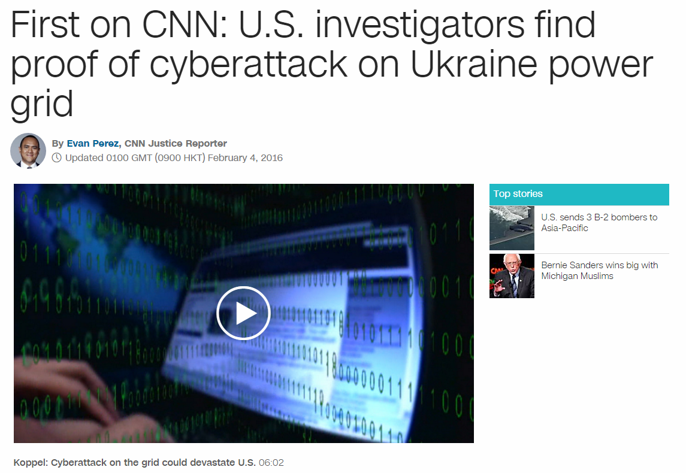
Cyber Security – booming problem

Slide 12
Digital substation – potential problem
Untrusted network
Possible Attackers:
States
Criminal Organizations
Script Kiddies
Insider
Control center
Remote acces
!
Station level
!
Router
!
!
Service PC
HMI PC
SCADA
Station computer
Switch
Field level
Switch
Switch
Switch
Switch
Switch
Switch
Switch
!
IEDs
Protection and
measurment
!
Unauthorized access
!
Misuse of administration rights
Malware
Attacks via Internet
Unproteced equipment – old firmware
!
!
!
!

Slide 13
Migration to Secure Substation
Security Controls
Untrusted network
Cyber security
measures
Control center
Remote acces
Station level
DMZ
Trusted zone
Access control and account management
Security logging
and monitoring
System hardening
Security patching, Backup and restore
Malware protection
Data protection, data integrity and system architecture
Secure remote access
Router
Service PC
HMI PC
SCADA
Station computer
Switch
Field level
Trusted zone
Switch
Switch
Switch
Switch
Switch
Switch
Switch
IEDs
Protection and
measurment

Slide 14
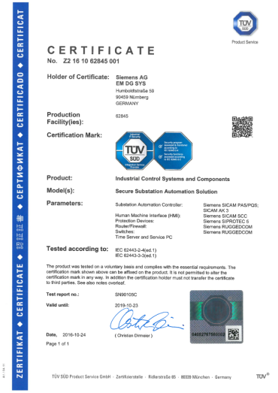
End-to-end Cyber Security
Secure Substation !
Siemens Secure Substation framework is certified
Siemens Secure Substation externally certified as per
IEC 62443-2-4 – Secure Processes
EC 62443-3-3– Technical security controls

Slide 15

HVALA!
Mario Valčić
Siemens d.d.
10000 Zagreb
Crotia
Mobile: +385 91 610 50 32
E-mail: mario.valcic@siemens.com
siemens.com/digital-substation

